Slide 1

Linux Plus for AWS and DevOps

Slide 2
Linux Environment Variables

Slide 3
Table of Contents
What are Environment Variables?
Common Environment Variables
Accessing the Variables
The PATH Variable
Quoting with Variables

Slide 4
What are Environment variables?
1

Slide 5
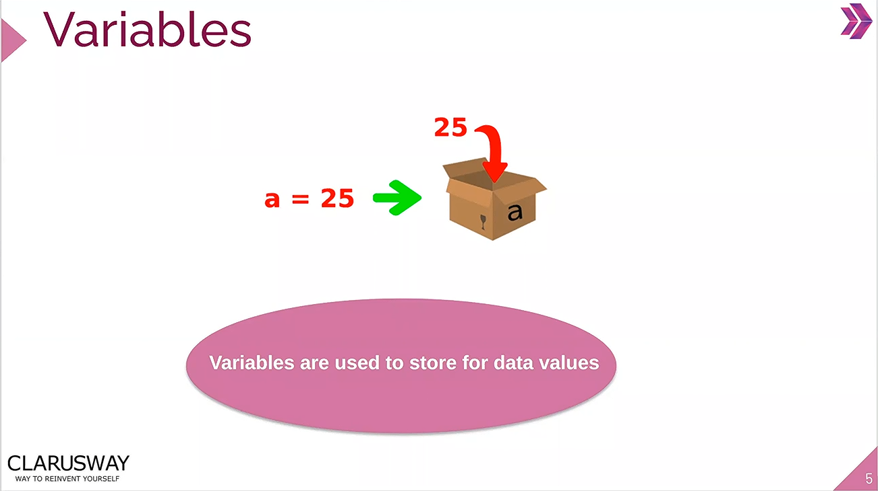

Slide 6
What are Environment variables?
An environment variable is a dynamic-named value that can affect the way running processes will behave on a computer.
Environment variables can be created, edited, saved, and deleted and give information about the system behavior.
Environment variables allow you to customize how the system works and the behavior of the applications on the system.
Notes:
Variables play an important role in computer programming because they enable programmers to write flexible programs. As they are related to the Operating system that we work on, it is important to know some of them and how we can influence them.
Avoids hardcoding varying information (uzun satır kodlar yazarken bizlere yardımcı oluyor ve daha flexible bir şekilde kodlarımızı yazıyoruz.)
Problem: different environments for different people
Admins cannot predict who needs what
different version of same software: collision of env variables
Solution: make it easy to switch environments
Environment modules: sets of environment settings
not limited to clusters

Slide 7
What are Environment variables?
A list of all specified environment variables can be viewed entering the env command.
There is nothing special about variable names, but, by convention, environment variables should have UPPER CASE names.

Slide 8
Common Environment Variables
2

Slide 9
Common Environment Variables
Variable | Description
PATH | This variable contains a colon (:)-separated list of directories in which your system looks for executable files.
USER | The username
HOME | Default path to the user's home directory
EDITOR | Path to the program which edits the content of files
UID | User's unique ID
TERM | Default terminal emulator
SHELL | Shell being used by the user
LANG | The current locales settings.

Slide 10
Common Commands
Command | Description
env | The env command is a shell command used to display and manipulate environment variables. It is used to list down environment variables.
printenv | The command prints all or the specified environment variables.
set | The command sets or unsets shell variables. When used without an argument it will print a list of all variables including environment and shell variables, and shell functions.
unset | The command deletes shell and environment variables.
export | The command sets environment variables.

Slide 11

Accessing Variable
3

Slide 12
Common Commands
Command | Description
echo $VARIABLE | To display value of a variable
env | Displays all environment variables
VARIABLE_NAME=variable_value | Create a new shell variable
unset | Remove a variable
export Variable=value | To set value of an environment variable

Slide 13
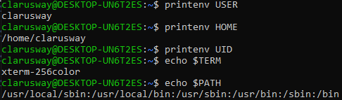
Accessing Variable
Display Path Environment Variable.
printenv or echo

Slide 14
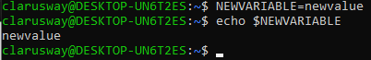
Define a New Variable
Define a new variable

Slide 15
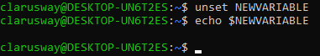
Remove a Variable
Remove a variable from the system.
unset

Slide 16


Slide 17
Exercise
Create a variable named MYVAR with the value of “my value”
Print value of the MYVAR variable to the screen
Assign “new value” to the MYVAR variable
Print value of the MYVAR variable to the screen
Delete MYVAR variable
Print value of the MYVAR variable to the screen
Notes:
MYVAR=”my value”
echo $MYVAR
MYVAR=”new value”
echo $MYVAR
unset $MYVAR
echo $MYVAR

Slide 18

The PATH Variable
4

Slide 19
The PATH Variable
When we want the system to execute a command, we almost never need to give the full path to that command.
For instance, we know that the ls command is in the /bin directory (you can check with ), yet we don't need to enter the /bin/ls command for the computer to list the content of the current directory.
This is maintained by the PATH environment variable. This variable lists all directories in the system where executable files can be found.

Slide 20
The PATH Variable
Display Path Environment Variable.
printenv
In this example, the /usr/local/sbin, /usr/local/bin, /usr/sbin, /usr/bin, /sbin and /bin directories are subsequently searched for the required program. The search will be stopped as soon as a match is found, even if not all directories in the path have been searched.

Slide 21
The PATH Variable
Add a New Directory to the Path.
export
Let's say you want to run that file called fun. You learned from running the find command that it's in a directory called /games/awesome. However, /games/awesome is not in your path, and you don't want to type the full path just to run the game. So you can add it to PATH variable with export command.

Slide 22
Quoting with Variables
5

Slide 23
Quoting
Quoting is used to disable special treatment of certain characters and words, as well as to prevent parameter expansion and preserve what is quoted.
The bash shell knows rare, important characters. For example, $var is used to extend the value of the element.
echo "$PATH" echo "$PS1"

Slide 24
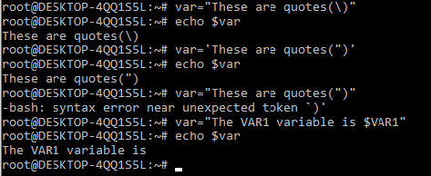
Quoting
Double Quotes
The double quote ( "quote" ) protects everything enclosed between two double quote marks except $, ', " and \.
echo "$SHELL"
echo "/etc/*.conf"
Single Quotes
The single quote ( 'quote' ) protects everything enclosed between two single quote marks.
echo '$SHELL’ echo '/etc/*.conf'
Backslash
Use the backslash to change the special meaning of the characters or to escape special characters within the text such as quotation marks.
echo "Path is \$PATH"

Slide 25
sudo Command
6

Slide 26
sudo Command
The sudo (superuser do) command gives some admin privileges to non-admin users.
When you put sudo in front of any command in terminal, that command runs with elevated privileges.
If you're not sure whether you're using sudo or su, look at the trailing character on the command line. If it's a pound sign (#), you're logged in as root.

Slide 27
sudo Command
Commands | Meaning
sudo -l | List available commands.
sudo command | Run command as root.
sudo -u root command | Run command as root.
sudo -u user command | Run command as user.
sudo su | Switch to the superuser account.
sudo su - | Switch to the superuser account with root's environment.
sudo su - username | Switch to the username's account with the username's environment.
sudo -s | Start a shell as root
sudo -u root -s | Same as above.
sudo -u user -s | Start a shell as user.

Slide 28

THANKS!
Any questions?

